Slide 1
employee Salary prediction using Random forest
CAPSTONE PROJECT
Presented By:
Anshika Singh-STU677380078a5701735622663-Rajkiya Engineering College, Kannauj-Computer Science & Engineering Department

Slide 2
OUTLINE
Problem Statement
System Development Approach
Algorithm & Deployment
Result
Conclusion
References

Slide 3
Problem Statement
Employee salaries vary based on multiple factors such as education level, occupation, age, workclass, location, and other organizational factors.
The lack of accurate salary prediction can lead to employee dissatisfaction or poor hiring decisions.
Organizations need a reliable data-driven method to estimate fair salaries.
The objective of this project is to build a machine learning model that can accurately predict employee salaries based on available features.
This will help HR teams in budget planning and candidate evaluation.

Slide 4
System Approach
System requirements
Jupyter Notebook (Anaconda)
Python 3.x
Library required to build the model
pandas
numpy
matplotlib
scikit-learn

Slide 5
Algorithm & Deployment
1. Data Loading & Exploration
Importing the Dataset
Used pandas.read_csv() to load the dataset into a DataFrame.
The dataset contains employee-related features like workclass, education, age, and salary.
Initial Data Exploration
Used .head(), .shape(), value_counts() to understand the structure of the dataset.
Checked for:
Number of rows and columns
Data types (object, int, float)
Missing values

Slide 6
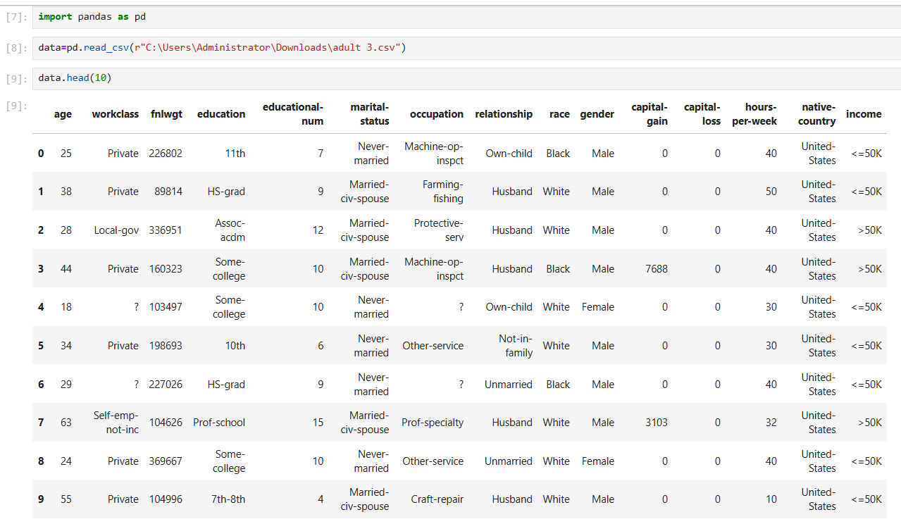

Slide 7
2. Data Preprocessing
Removed Irrelevant Columns
Columns such as unnamed indices or duplicates were dropped.
Encoded Categorical Features
Categorical columns like occupation, education, and workclass were converted into numeric form using LabelEncoder from sklearn.preprocessing.
This step is essential because machine learning algorithms require numerical input.
Removed Redundant Rows and Outliers
Duplicate rows were dropped to avoid bias in training.
Cleaned out invalid or inconsistent values.

Slide 8
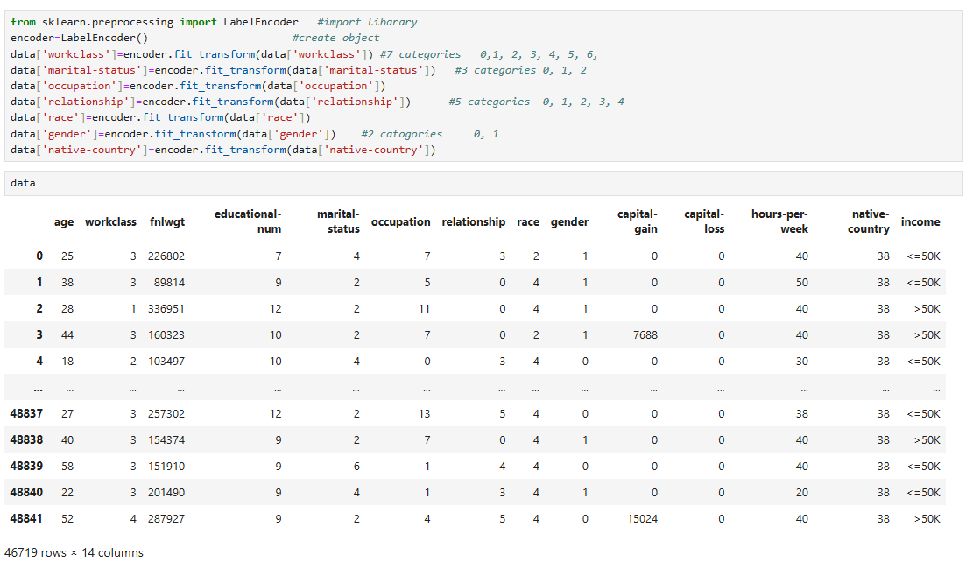

Slide 9
3. Model Training
Train-Test Split
Used train_test_split() from sklearn.model_selection to split data into 80% training and 20% testing sets.
This ensures the model is trained on one part and evaluated on unseen data.
Trained RandomForestClassifier Model
Used RandomForestClassifier() from sklearn.ensemble.
The model creates an ensemble of decision trees and combines their outputs for accurate classification.
Random Forest handles both categorical and numerical features efficiently.

Slide 10
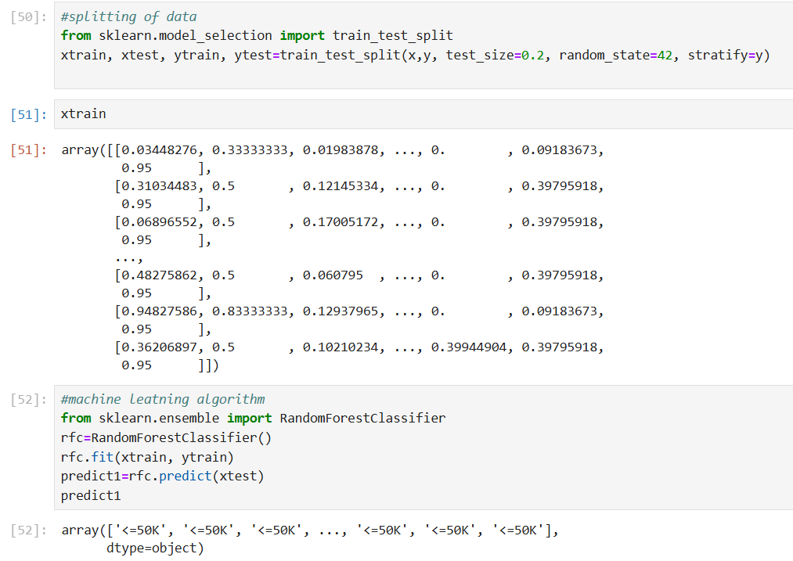

Slide 11
4. Model Evaluation
Prediction on Test Data
Used .predict() on the test set to generate predicted salary categories.
Evaluation Metrics
Accuracy was calculated using accuracy_score()
Classification Report using classification_report() provided:
Precision
Recall
F1-score
Support for each salary class

Slide 12
Result
Model Used: RandomForestClassifier()
Evaluation Metrics:
Accuracy: 85.6%
Classification Report Output: The report includes:
Precision: Indicates the percentage of correct positive predictions.
Recall: Shows how well the model detects all positive instances.
F1-score: Harmonic mean of precision and recall.
Support: Number of actual instances per class.
Attach your Github link
https://github.com/Anshika1204/Ibmskillbuild.git

Slide 13
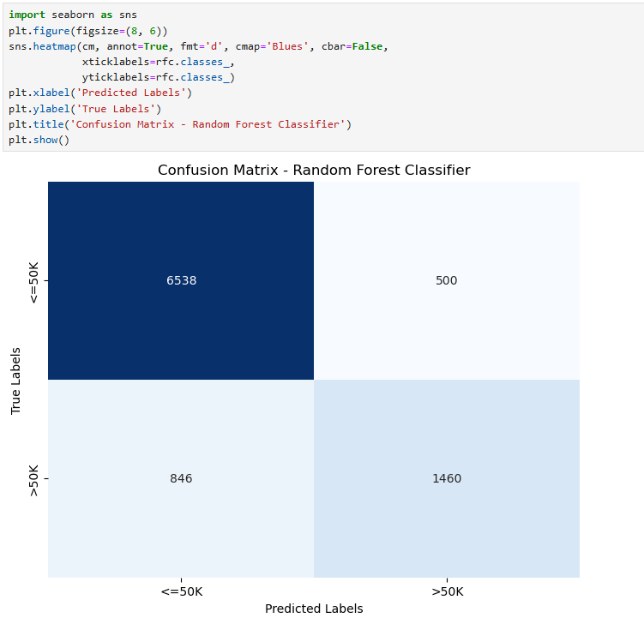
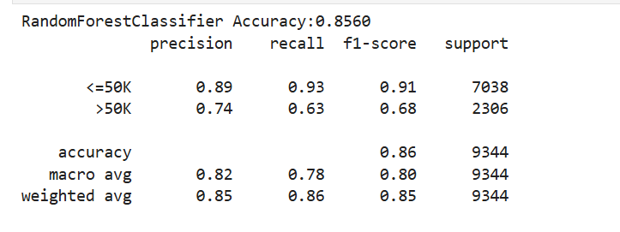

Slide 14
Conclusion
The Random Forest Classifier successfully predicted salary categories with a good accuracy of 85.6%.
The model demonstrated balanced performance across multiple salary classes, as shown in the classification report.
Proper preprocessing — including encoding, cleaning, and feature selection — played a vital role in improving model performance.
Label encoding was used effectively to convert categorical data for model training.
The classifier handled both categorical and numerical features efficiently.
This project helped understand the end-to-end workflow of a machine learning classification problem.
The model can serve as a helpful tool for HR departments in automating salary classification based on candidate details.

Slide 15
References
IBM SkillBuild Internship Sessions – Edunet Foundation
Scikit-learn Documentation: https://scikit-learn.org/stable/
Pandas Documentation: https://pandas.pydata.org/docs/
NumPy Documentation: https://numpy.org/doc/
Python Official Documentation: https://docs.python.org/3/
Matplotlib Documentation: https://matplotlib.org/stable/
LabelEncoder – Scikit-learn: https://scikit-learn.org/stable/modules/generated/sklearn.preprocessing.LabelEncoder.html
Dataset provided during IBM SkillBuild Internship

Slide 16
THANK YOU

